Slide 1
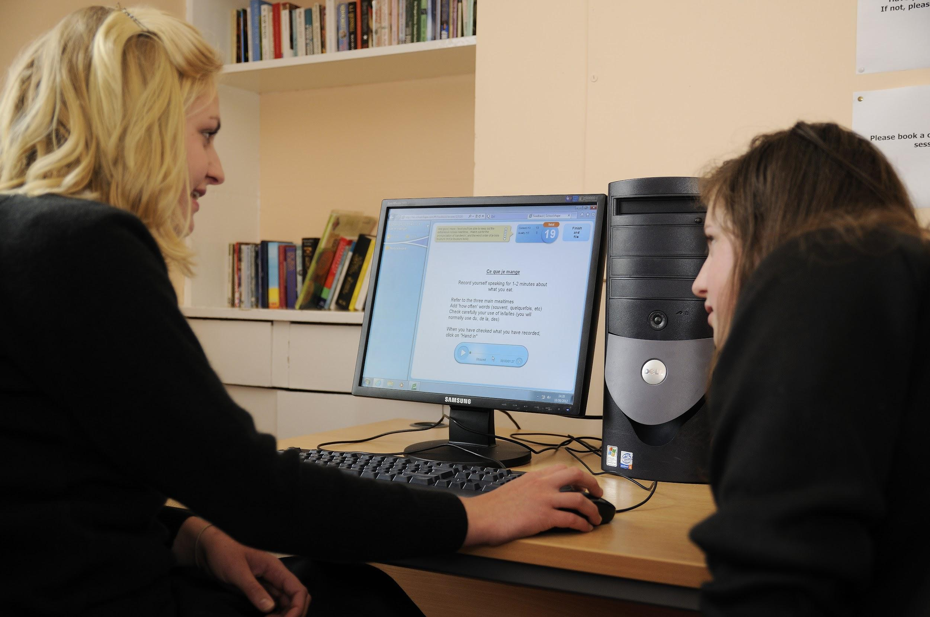
Online Language Lab: Zuma Marketing
'The Schoolshape Language Laboratory'
info@schoolshape.com

Slide 2
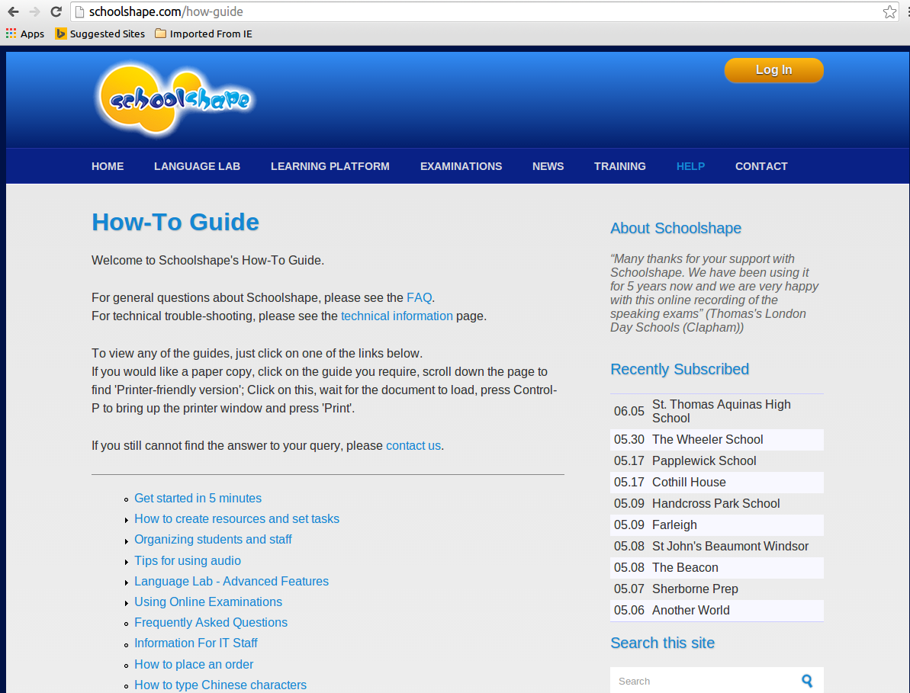
Language Lab ‘How-to’ Guide
Notes:
All the functions of the Schoolshape Lab are described at schoolshape.com/how-guide where there are full descriptions on a wide range of subjects from ‘How to get started’ to ‘How to input Chinese characters’.

Slide 3
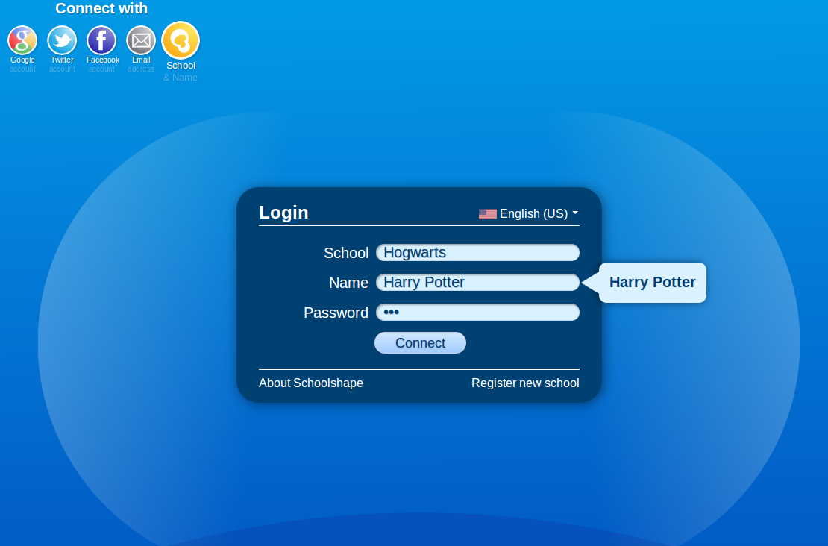
Log in at lab.schoolshape.com
Notes:
To access the Schoolshape Language Laboratory, students log in at lab.schoolshape.com. If their school has a custom lab, they can log in from their institution’s website. If they wishe they can use their social networking details, or enter their school, name and Schoolshape password.

Slide 4
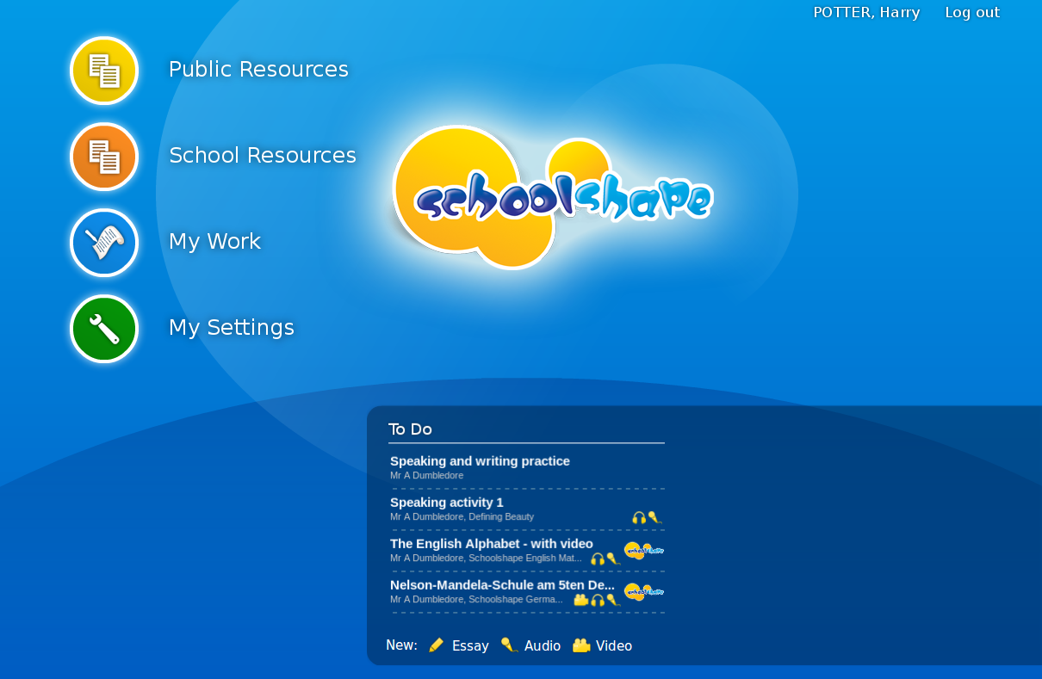
Student’s Home Page with ‘To Do’ list
Notes:
When the student logs into the Schoolshape Lab, he will be presented with the ‘Home Page’ on which is a ‘To Do’ list. Work is accesssed by clicking on one of the listed activities assigned by teachers.

Slide 5
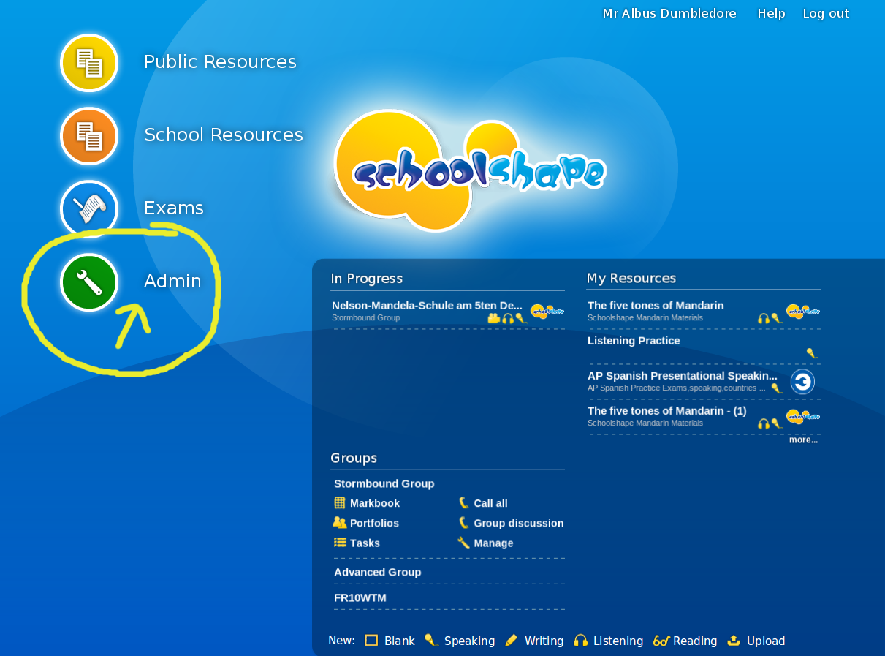
Teacher’s home page
Notes:
On the Schoolshape teacher’s Home Page you can organise all the settings for teachers and students by clicking the ‘Admin’ button

Slide 6
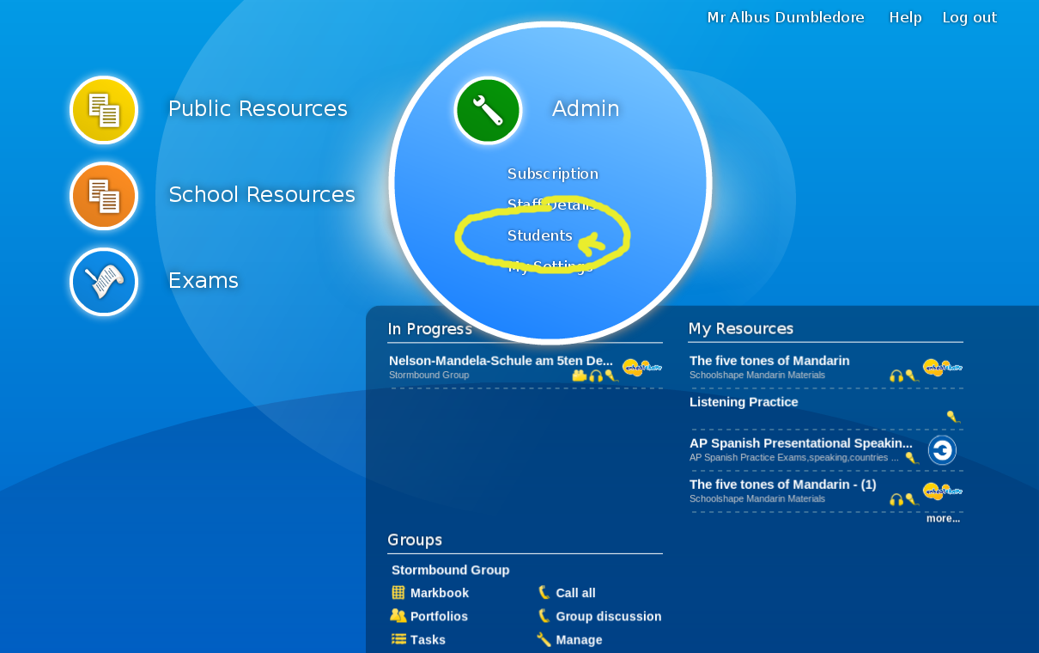
Selecting students
Notes:
To add, remove or edit the names of individual students or groups in the Schoolshape Language Lab, select ‘Students’ in the ‘Admin’ dropdown list.

Slide 7
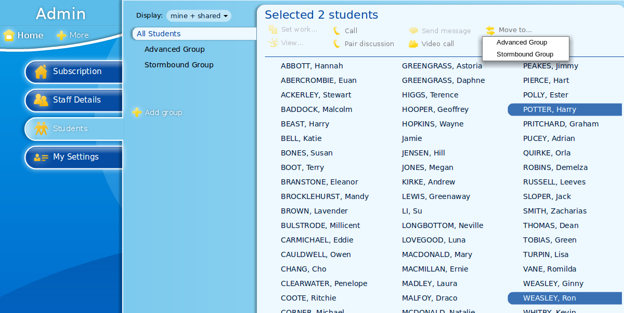
Organizing students
Notes:
In Schoolshape, the main default student group is called ‘All Students’. The names of all the students in the school are always kept in this group, no matter how many other groups are created. Any number of new groups can be added or removed using the menus, thus allowing for completely flexible differentiation of tasks or courses. Names can be dragged across or copied using the ‘Move to’ button. The groups can be shared with other teachers in the school if desired. From this screen teachers can also access students’ portfolios and perform other language lab functions such as make audio or video calls to students.

Slide 8
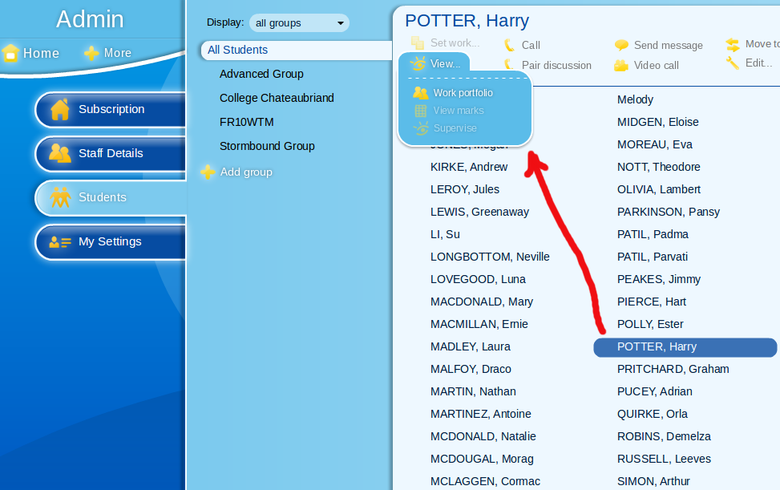
Selecting student’s work portfolio
Notes:
To view a student’s portfolio in the Schoolshape lab, click the student’s name then select ‘View Portfolio’ in the ‘View’ menu.

Slide 9
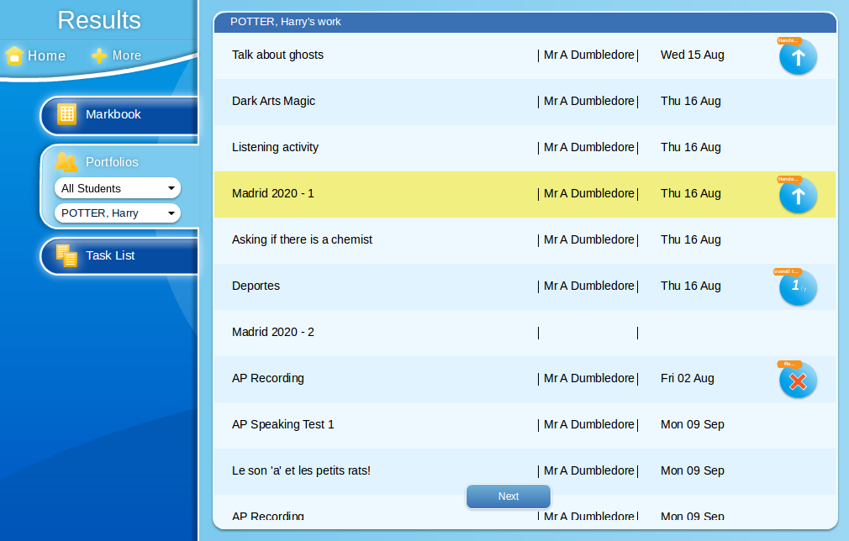
Harry Potter’s work portfolio
Notes:
This is an example student work portfolio in the Schoolshape Language Lab. The list contains the name of each task, the teacher who assigned the work, and the date completed.

Slide 10
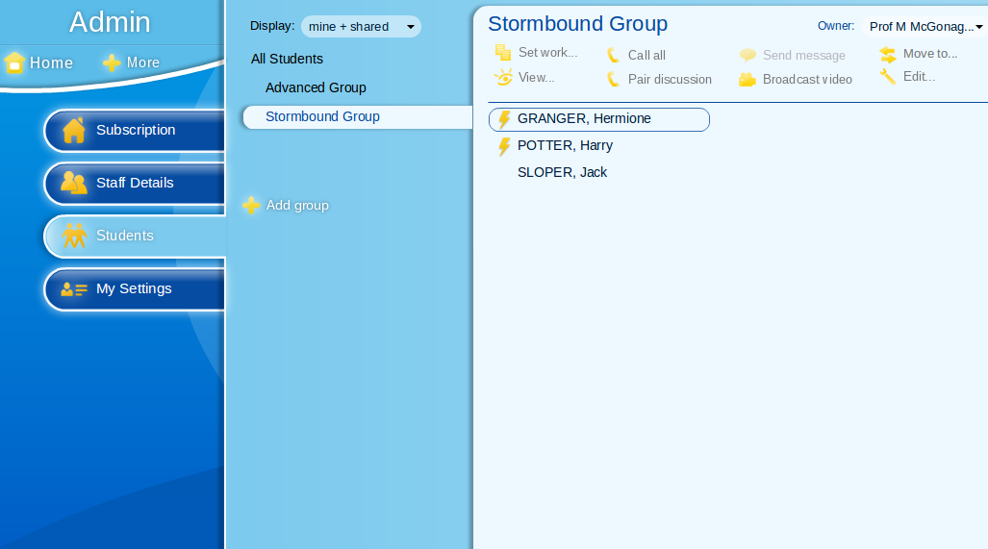
Students who are online

Slide 11
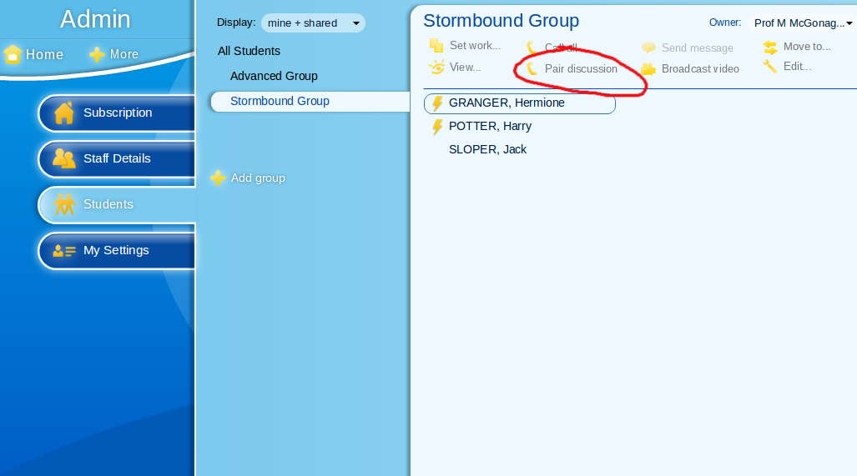
Selecting pair discussion

Slide 12
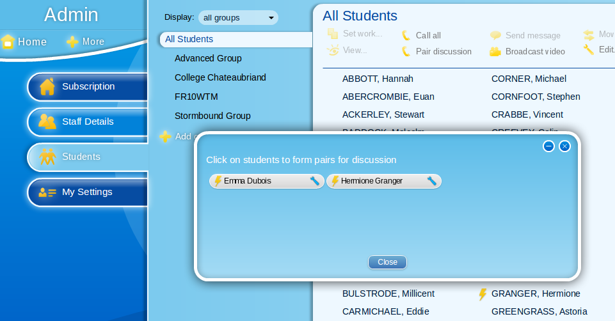
Pairing locally or internationally

Slide 13
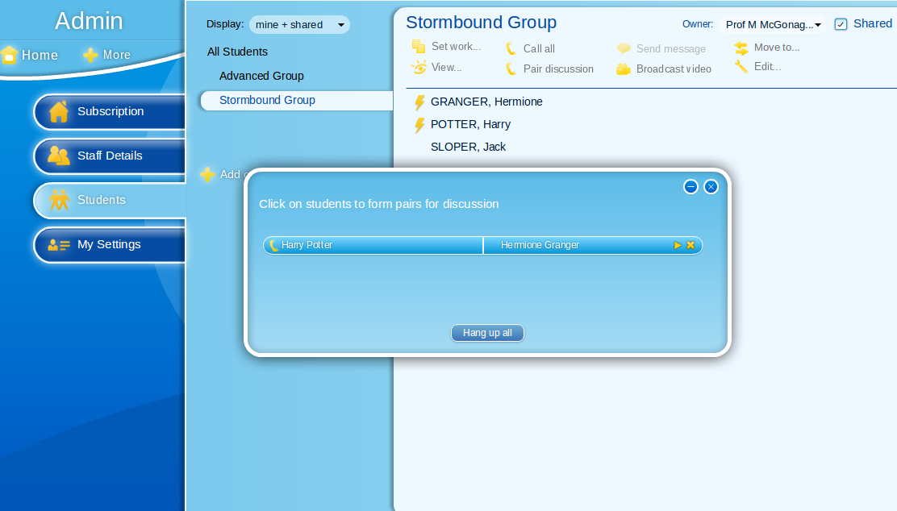
Paired students

Slide 14
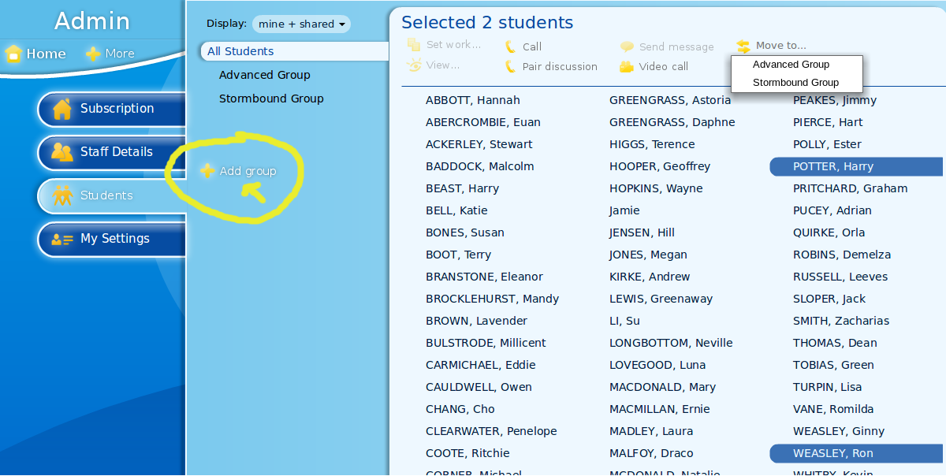
Adding a new group

Slide 15
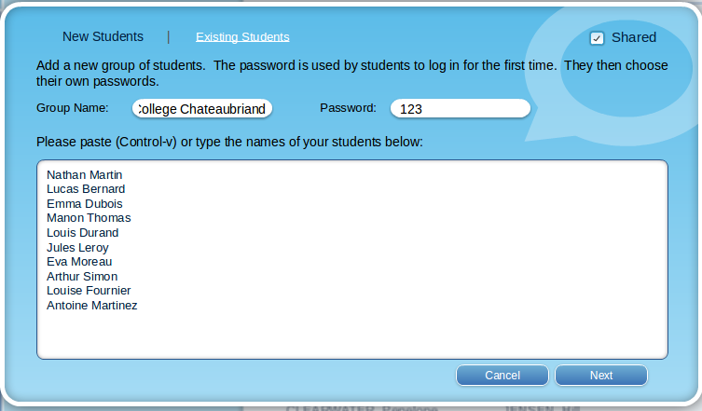
Adding ‘College Chateaubriand’

Slide 16
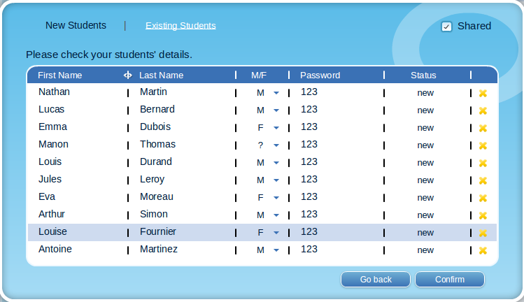
New group confirmation screen

Slide 17
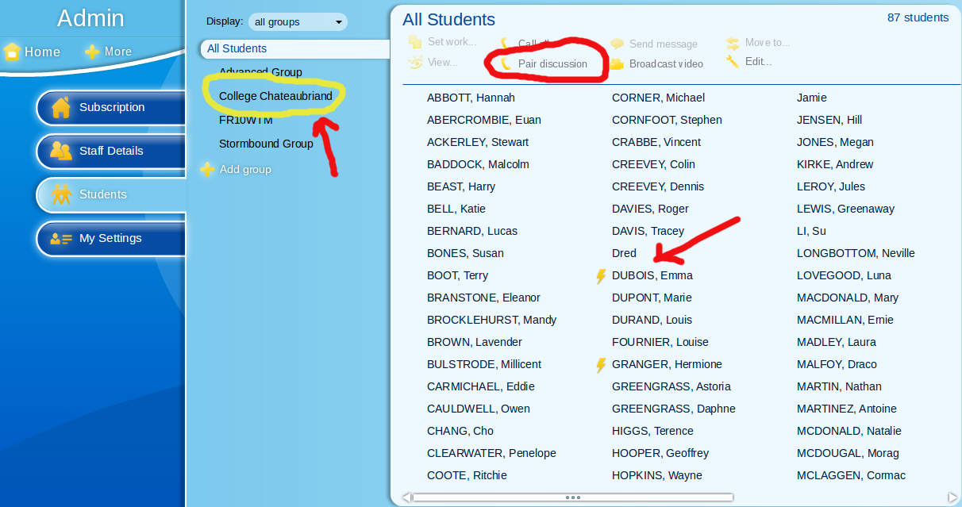
New students now available, 1 online

Slide 18
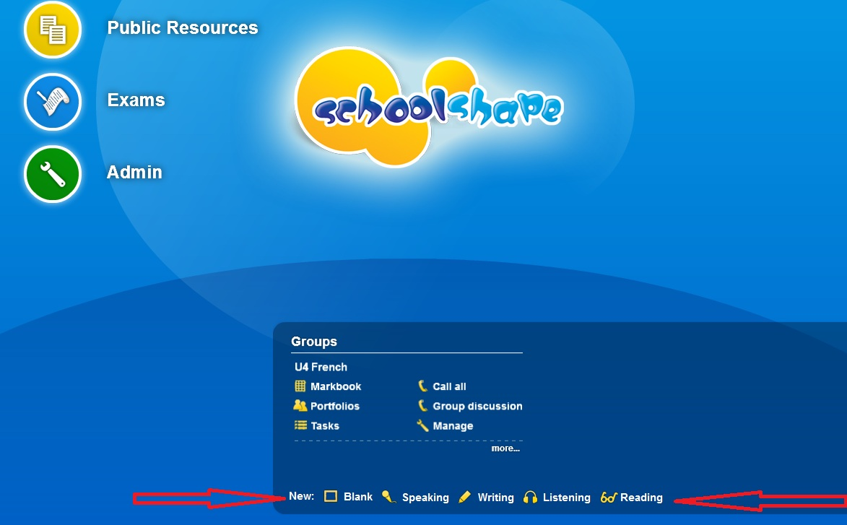
Teacher’s 'Home Page': Resources

Slide 19
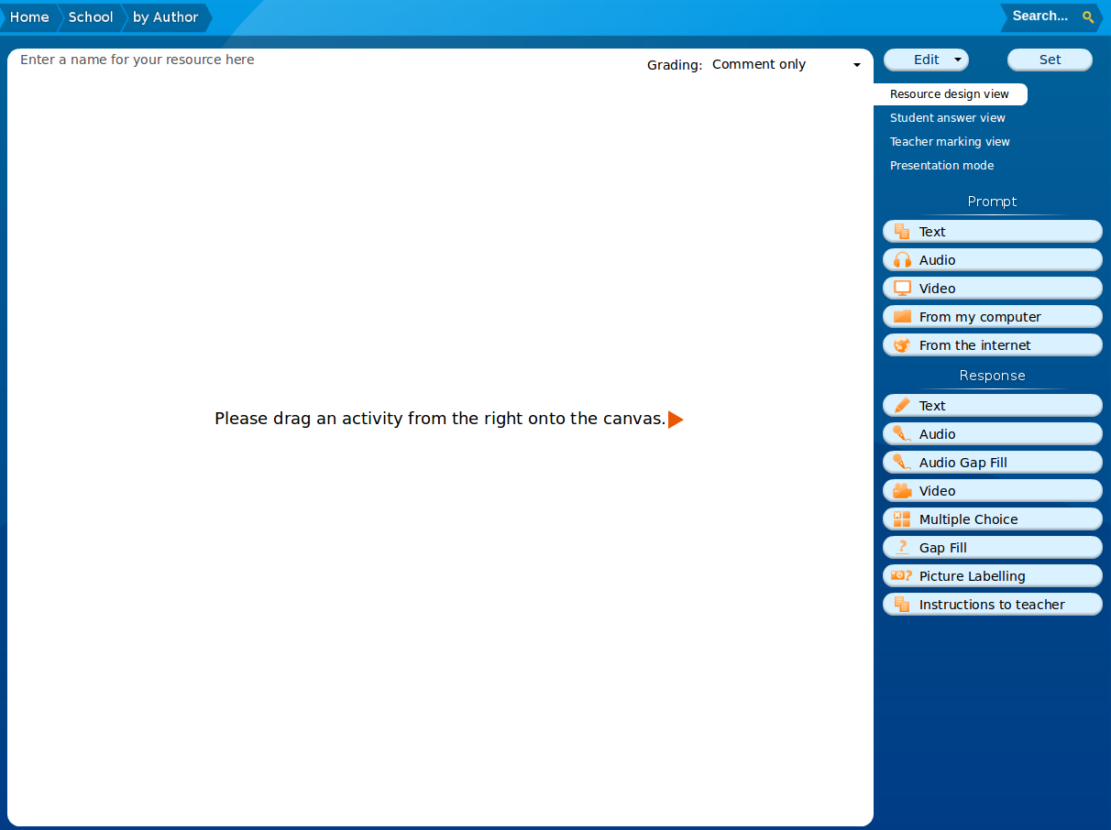
Multimedia ‘worksheet’ for creating a resource

Slide 20
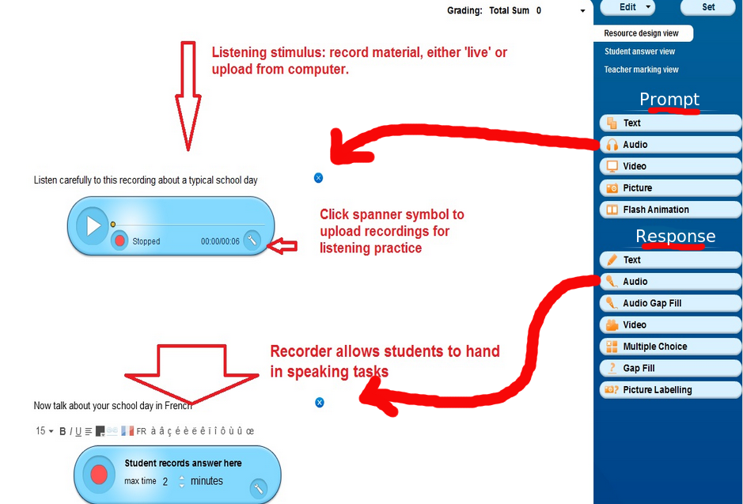
Making your own resource: listening & speaking

Slide 21
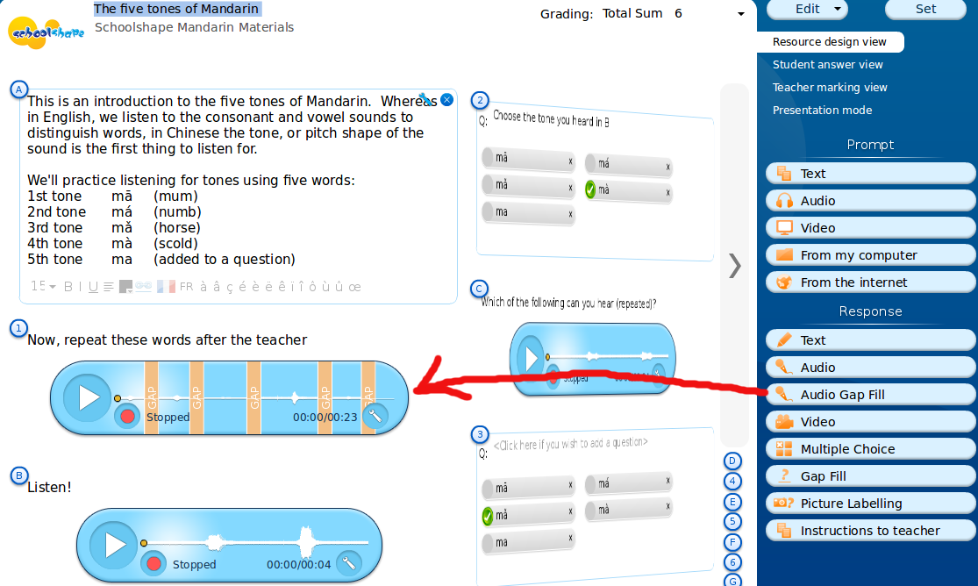
Audio Gap Fill - Resource Design View

Slide 22
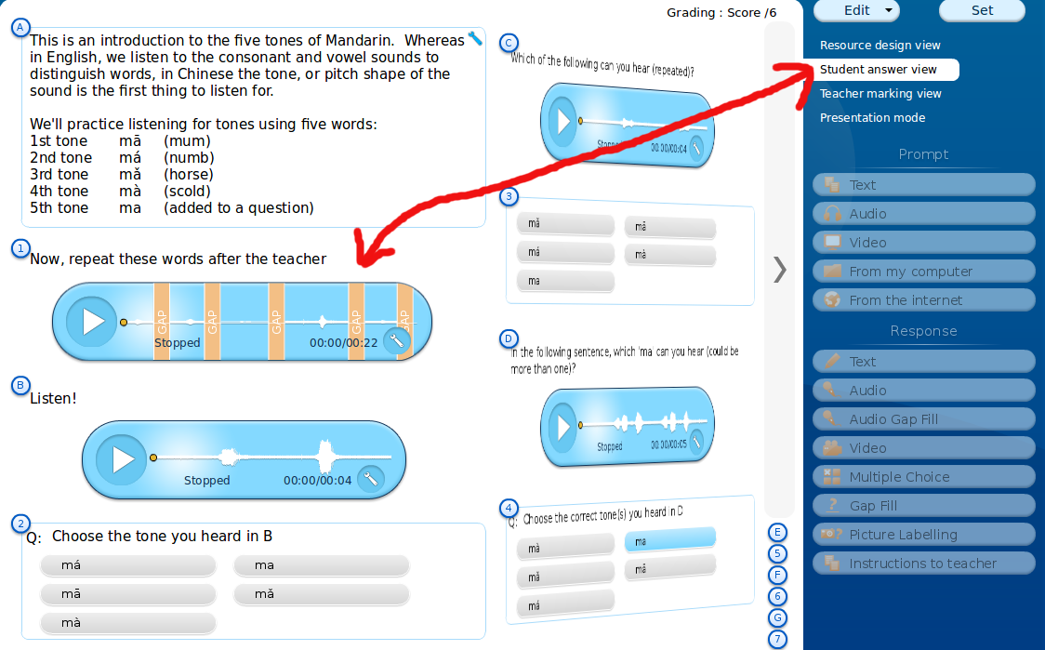
Audio Gap Fill - Student Answer View

Slide 23
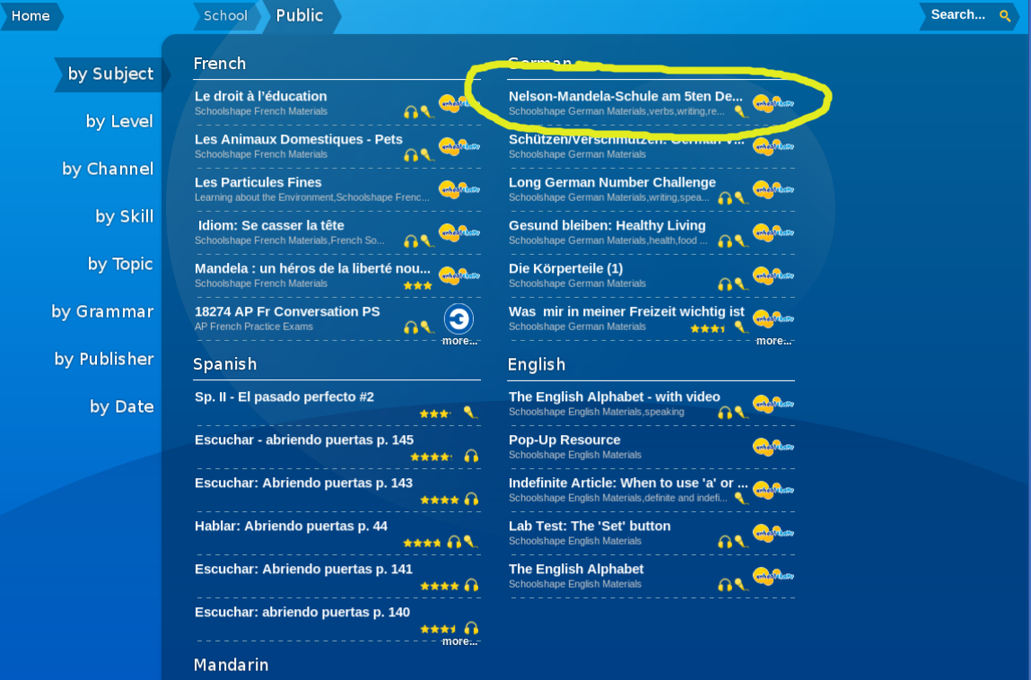
Selecting a resource from the library

Slide 24
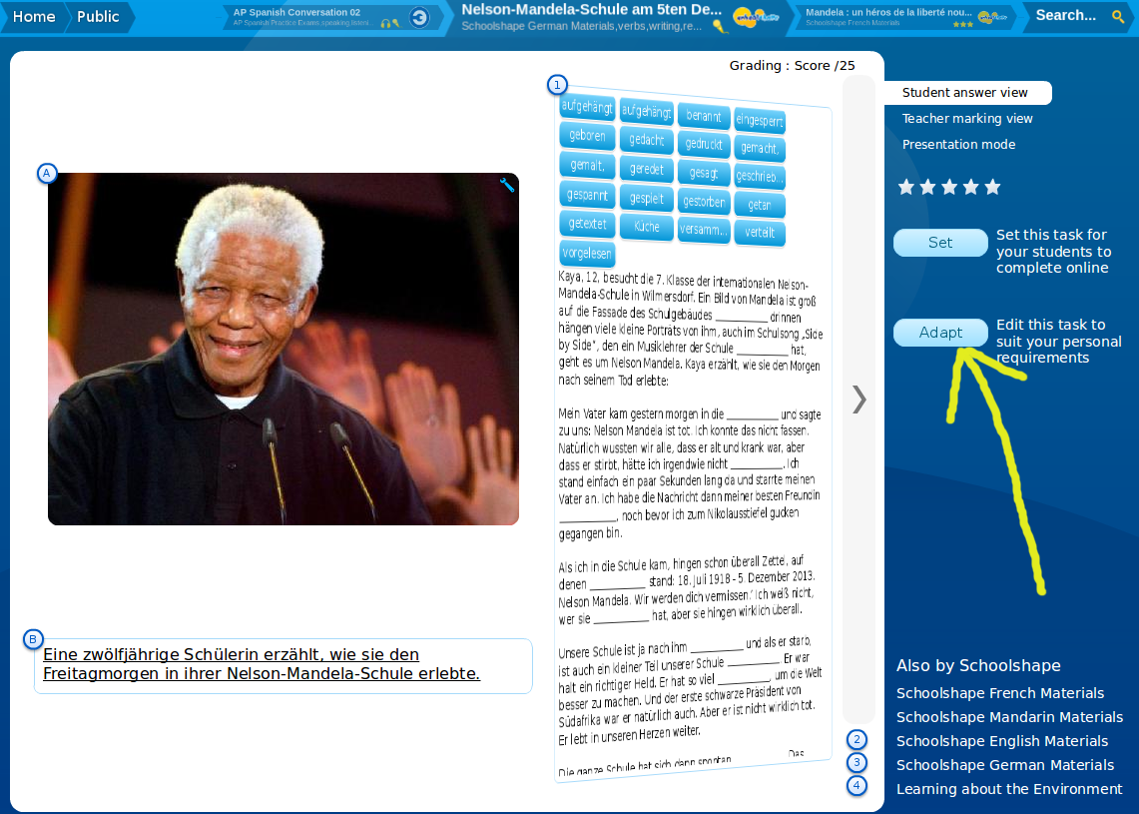
Reviewing a library resource (student view)

Slide 25
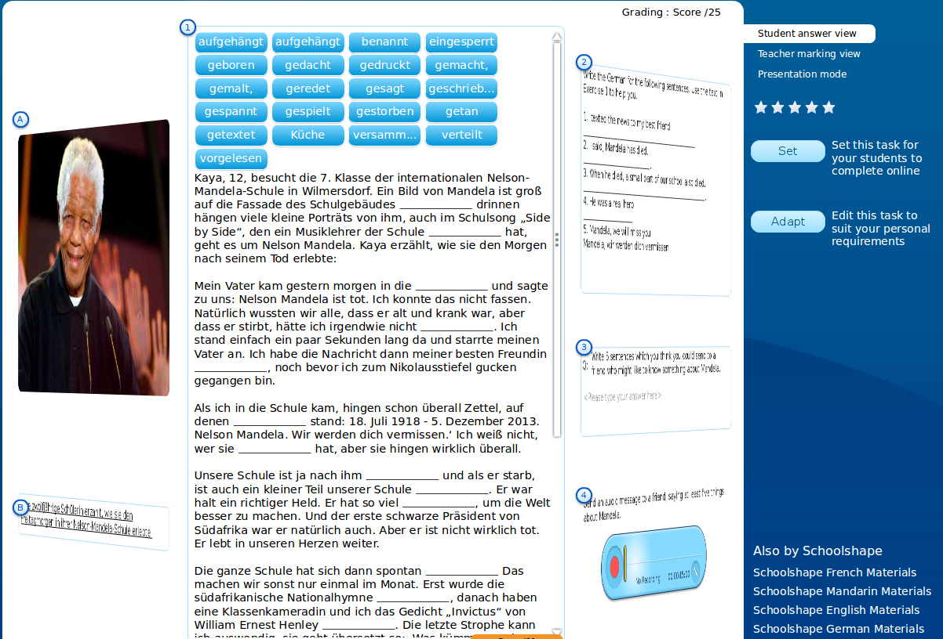
Reviewing a library resource (student view)

Slide 26
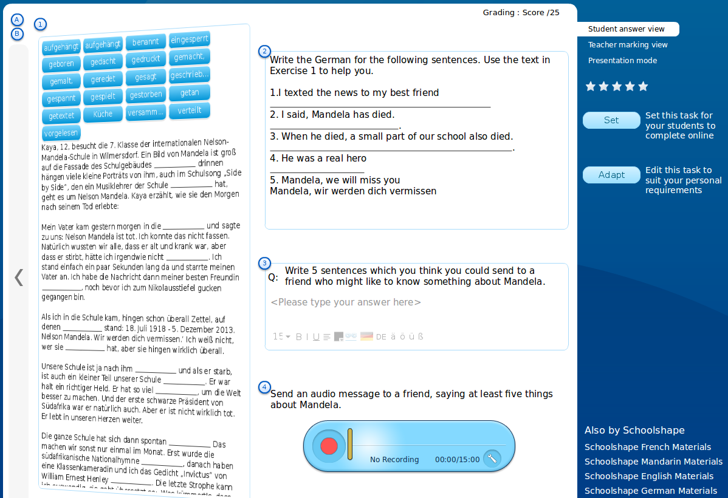
Reviewing a library resource (student view)

Slide 27
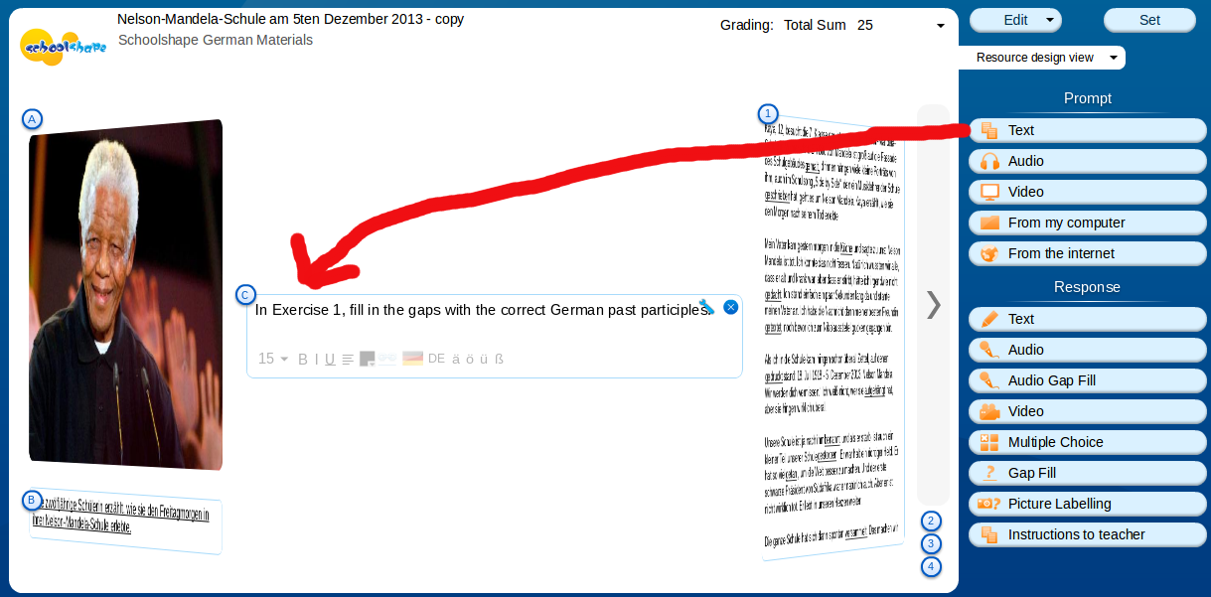
Adding a text prompt box

Slide 28
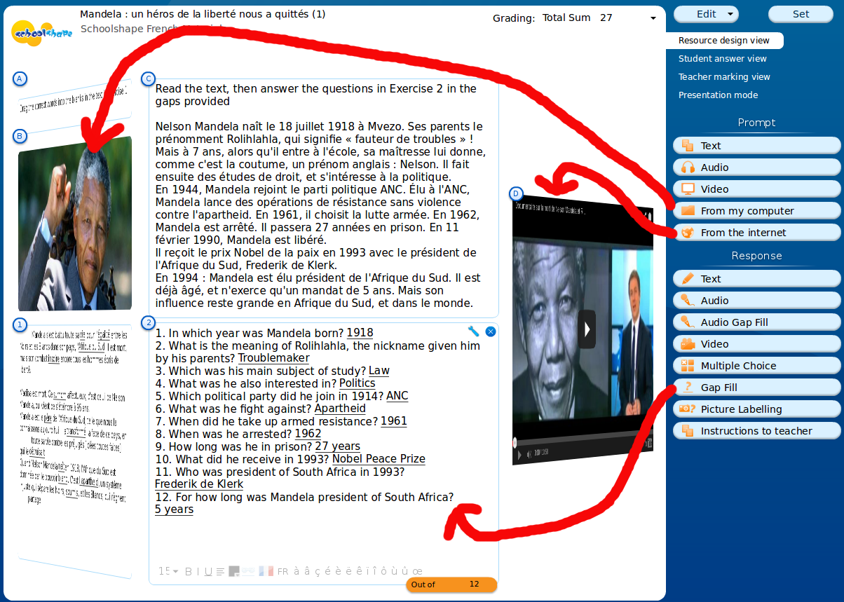
Building worksheet prompts and responses

Slide 29
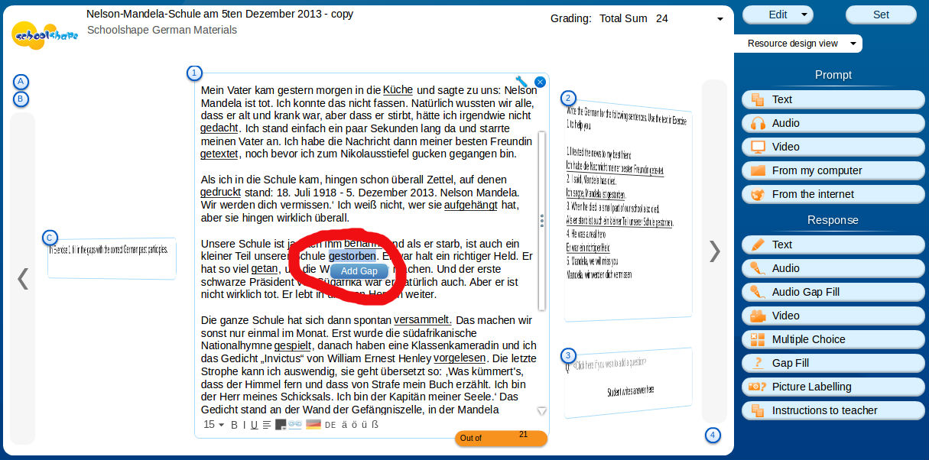
Adding gaps to form a cloze exercise

Slide 30
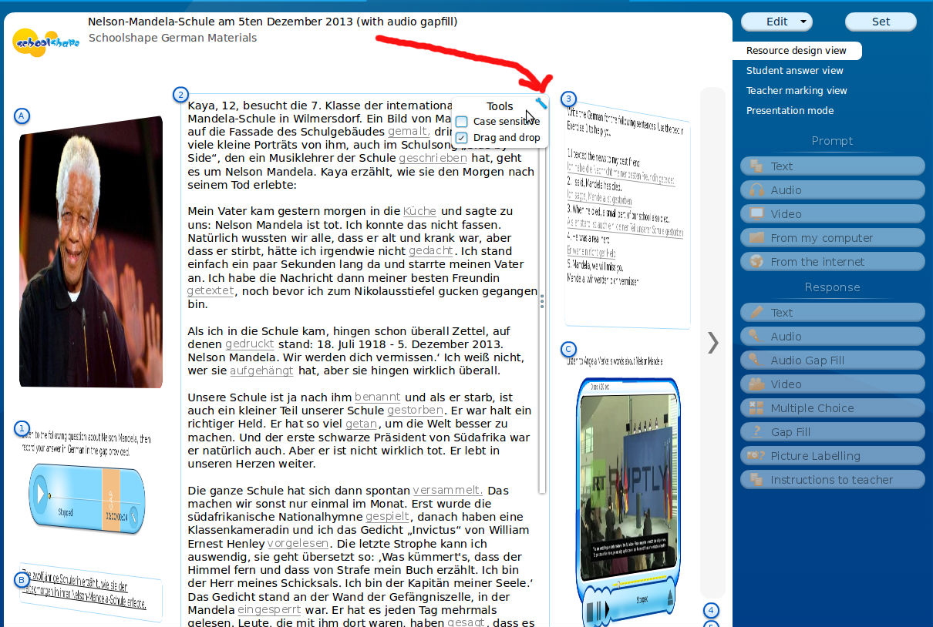
‘Drag and drop’ and ‘case sensitive’

Slide 31
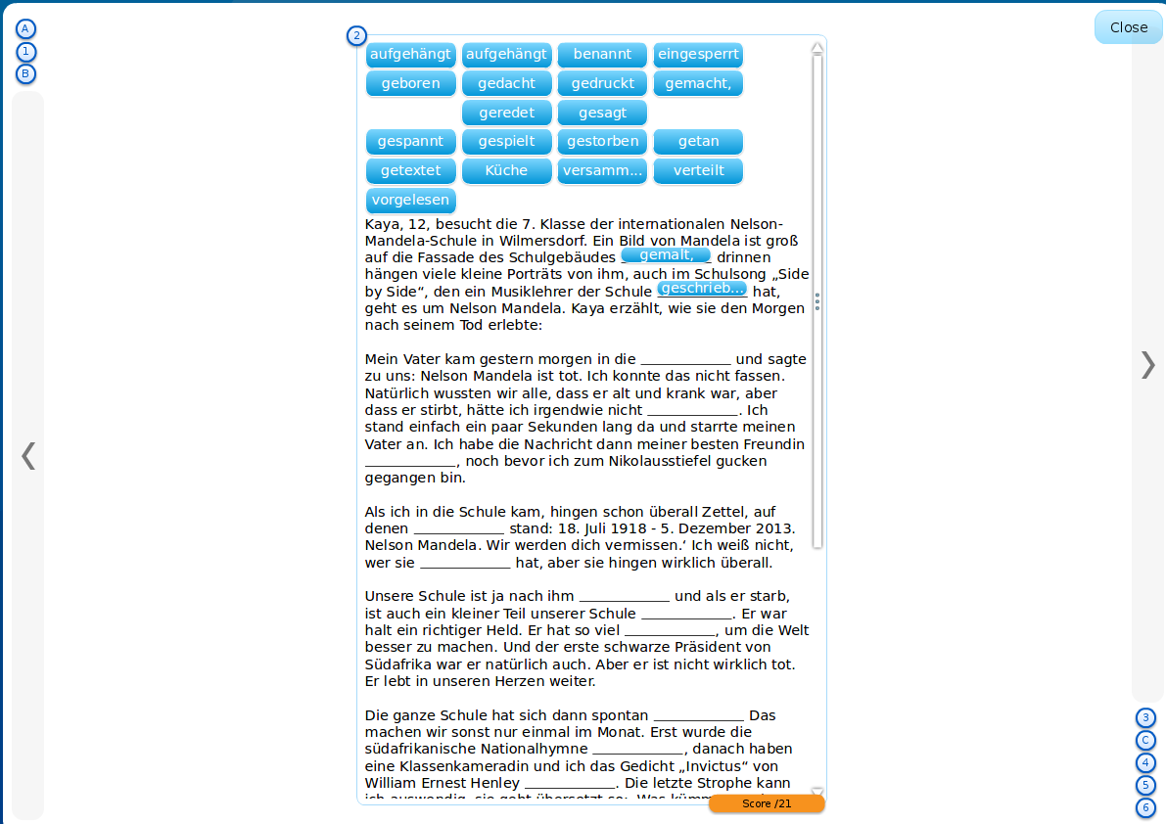
Gap fill exercise - presentation mode

Slide 32
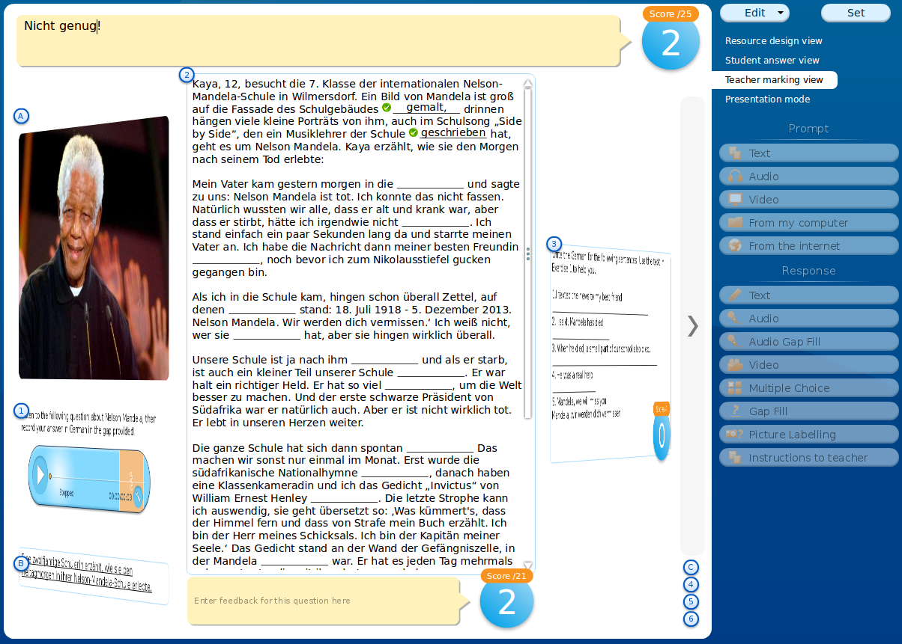
Gap fill exercise - teacher marking view

Slide 33
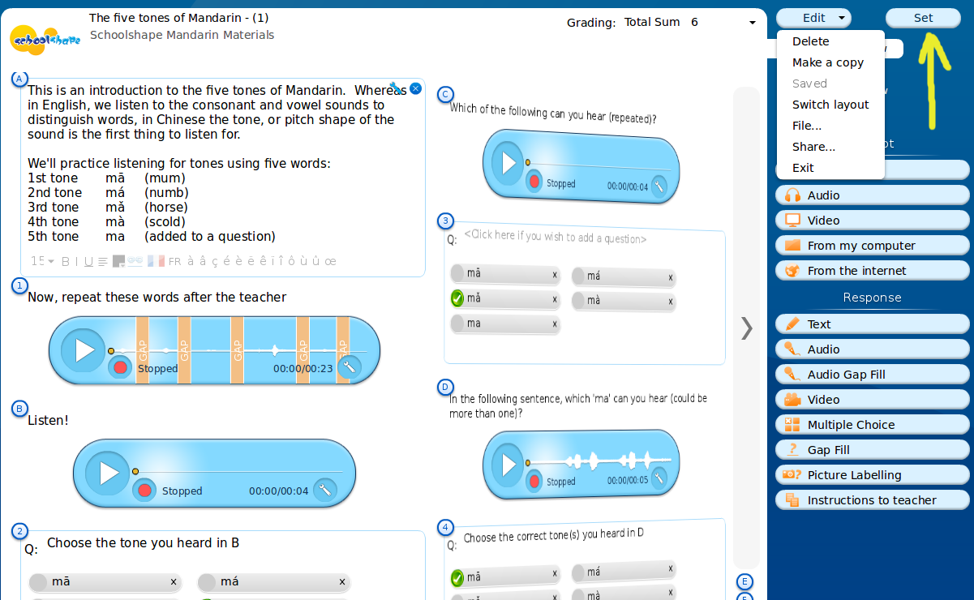
Setting (assigning) a resource as a task

Slide 34
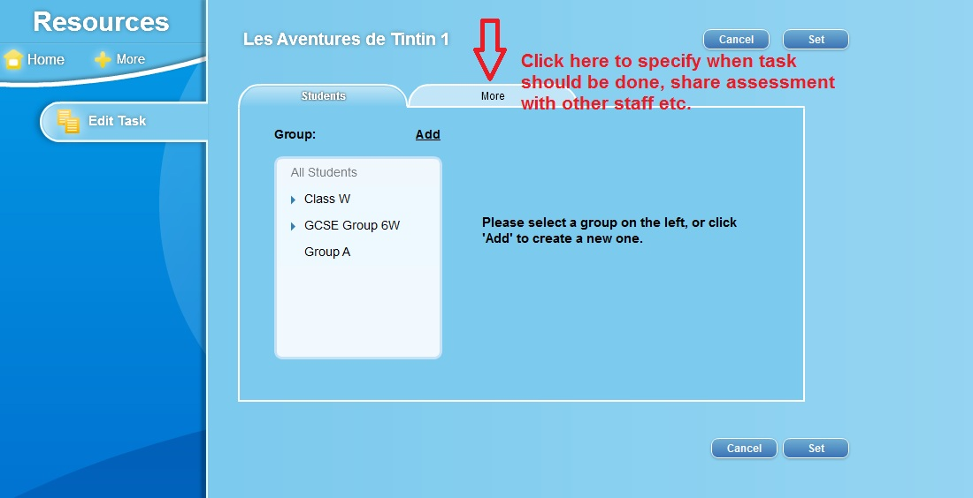
Differentiate students/groups

Slide 35
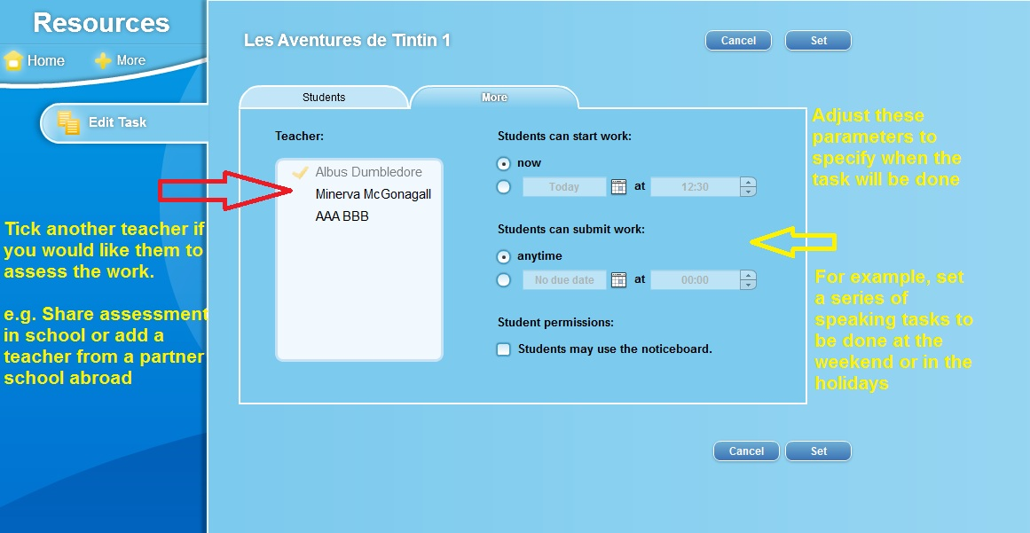
Specify when task is to be done

Slide 36
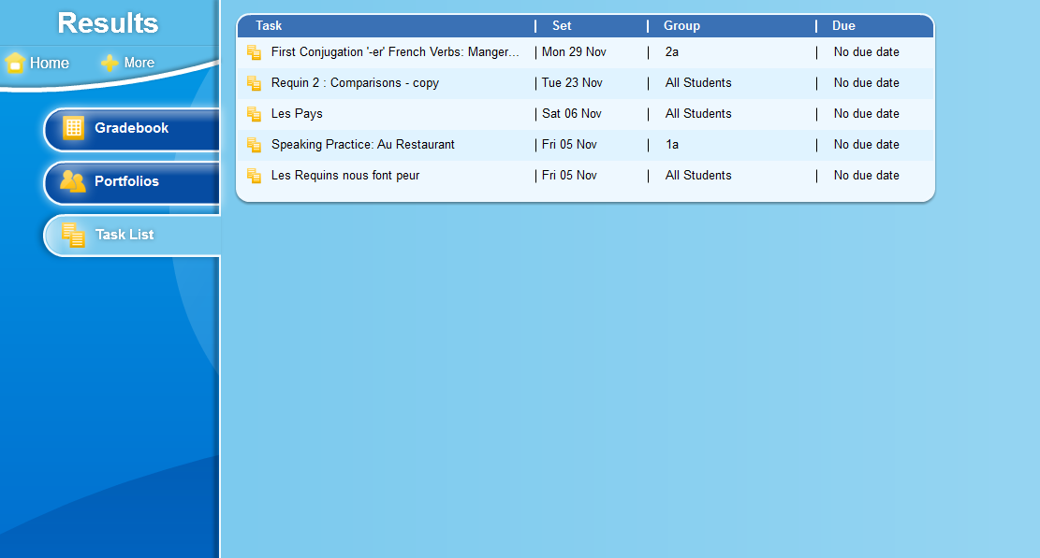
List of assigned tasks

Slide 37
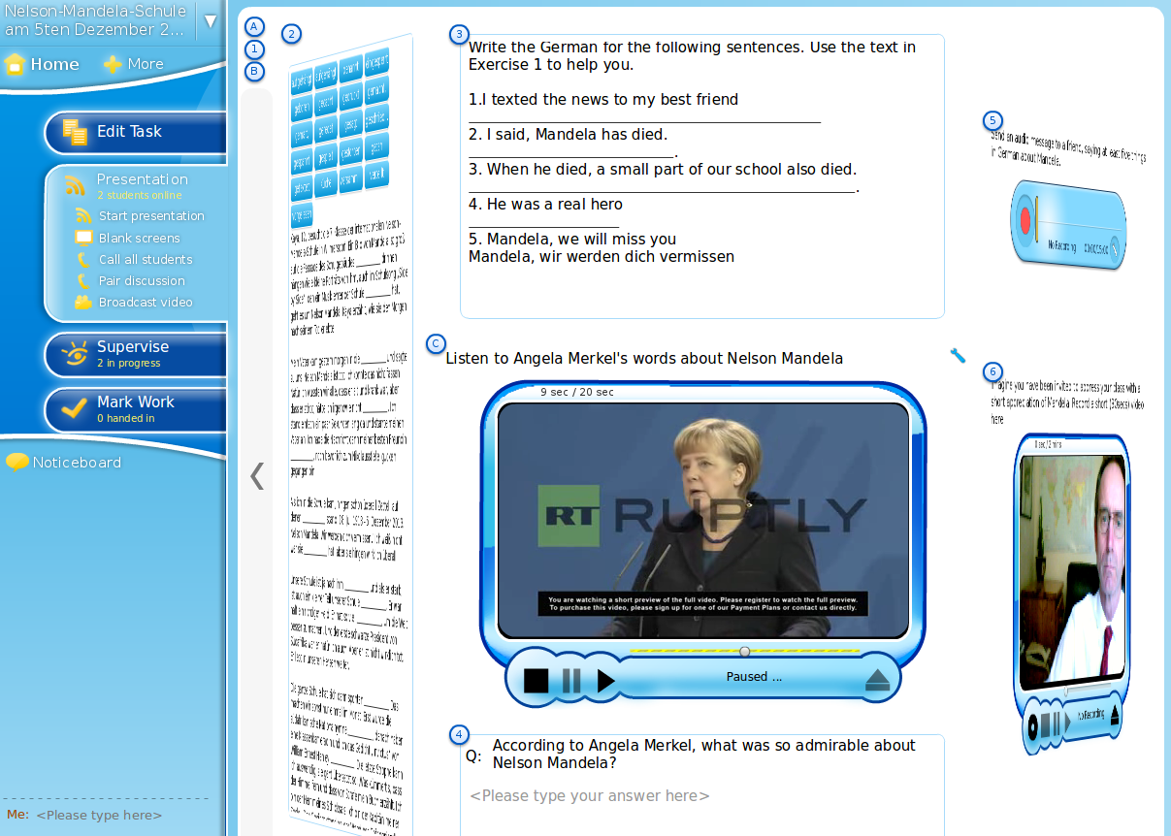
Presenting the task to students
Notes:
After a while, students progress further with the task.
Here we see that Hermione is racing ahead. Although Neville has managed to get the right number of body parts finally, he is still behind.​​
*

Slide 38
Gap fill exercise - presentation mode

Slide 39
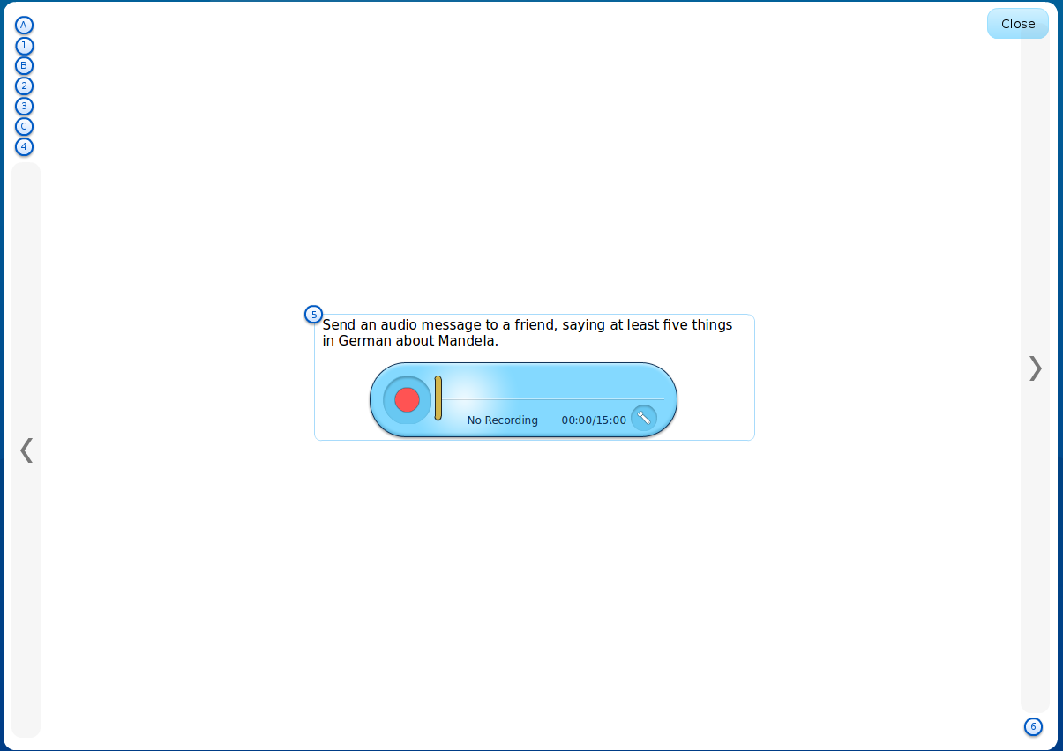
Recording exercise - presentation mode

Slide 40
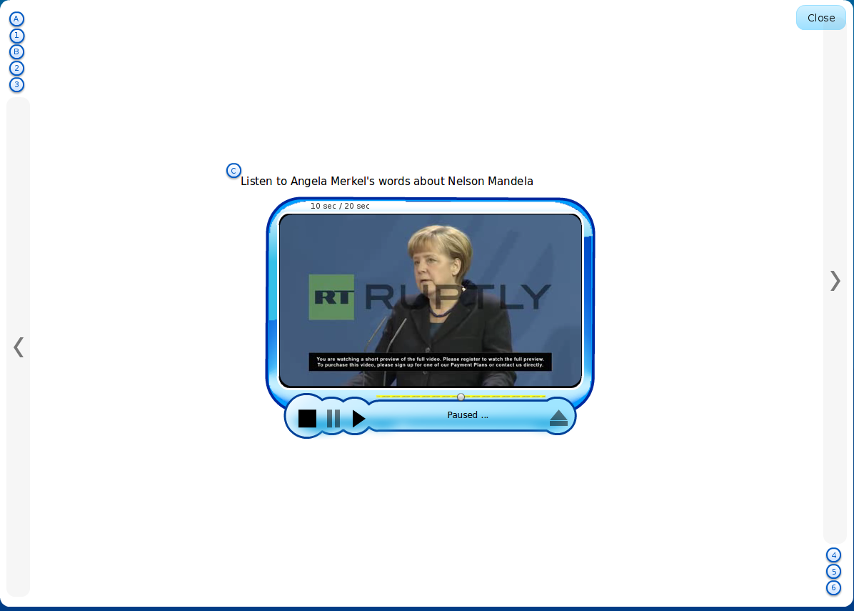
Video prompt - presentation mode

Slide 41
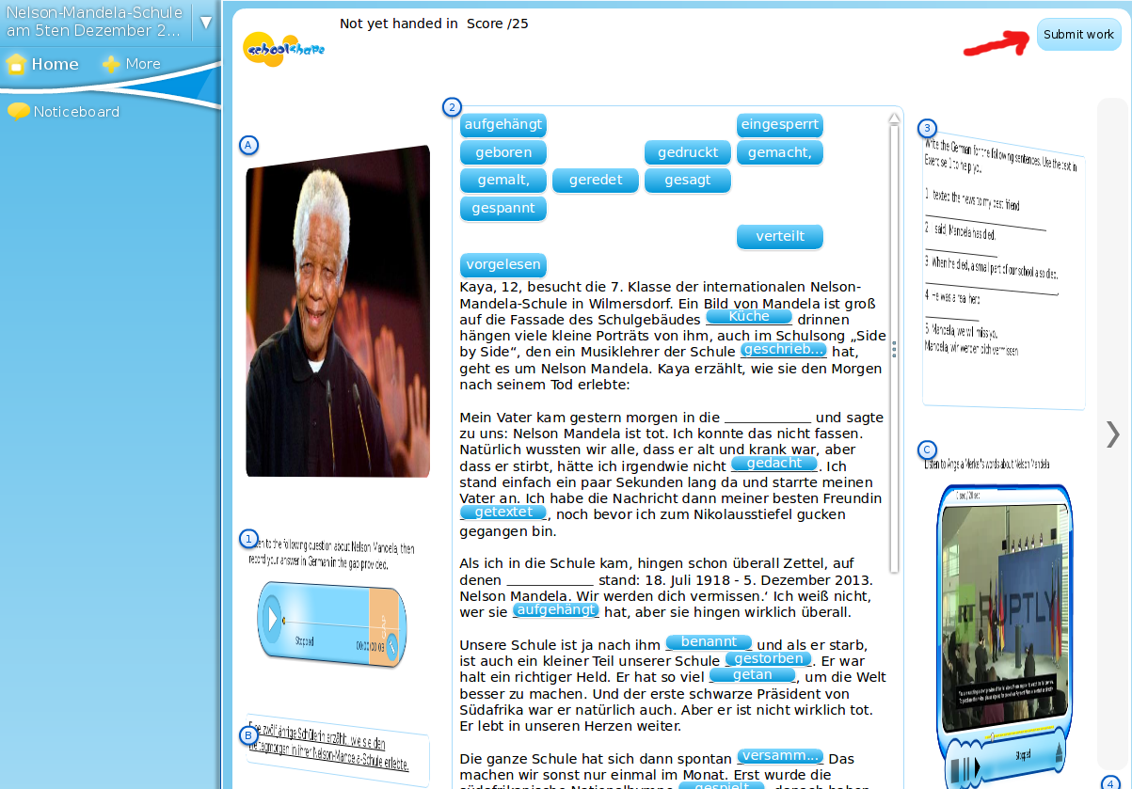
Student submits work

Slide 42
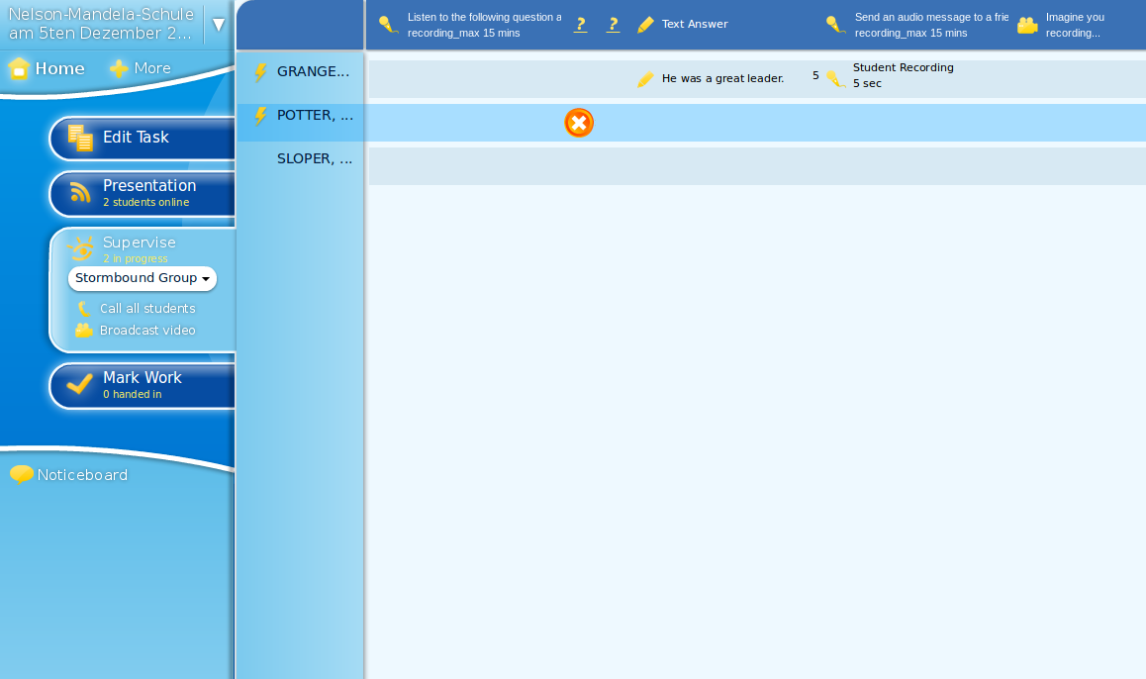
Supervise
Notes:
*

Slide 43
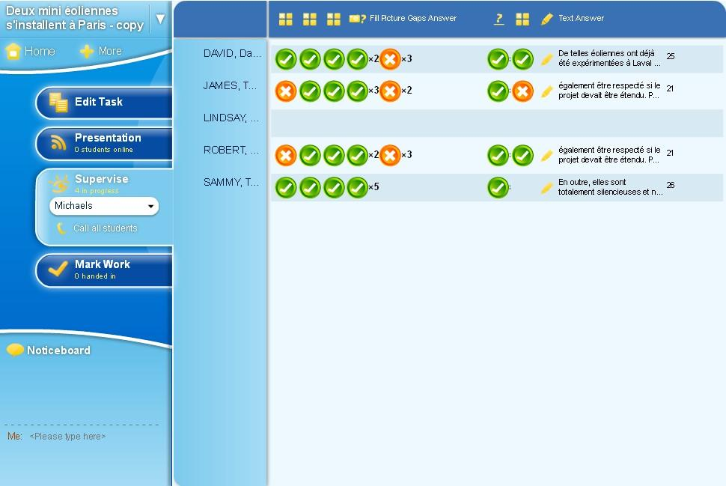
Example of another task in progress
Notes:
*

Slide 44
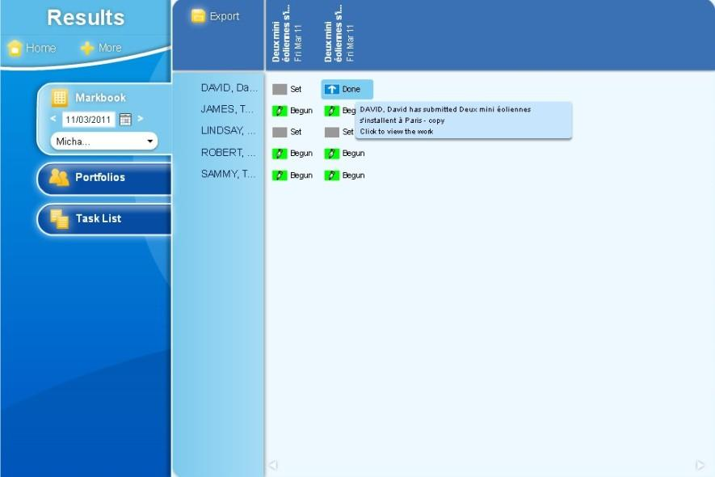
Work handed in

Slide 45
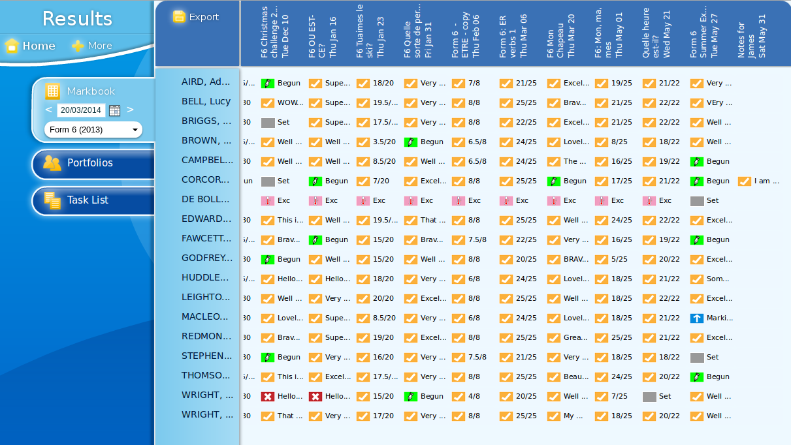
Example Markbook
Notes:
*

Slide 46
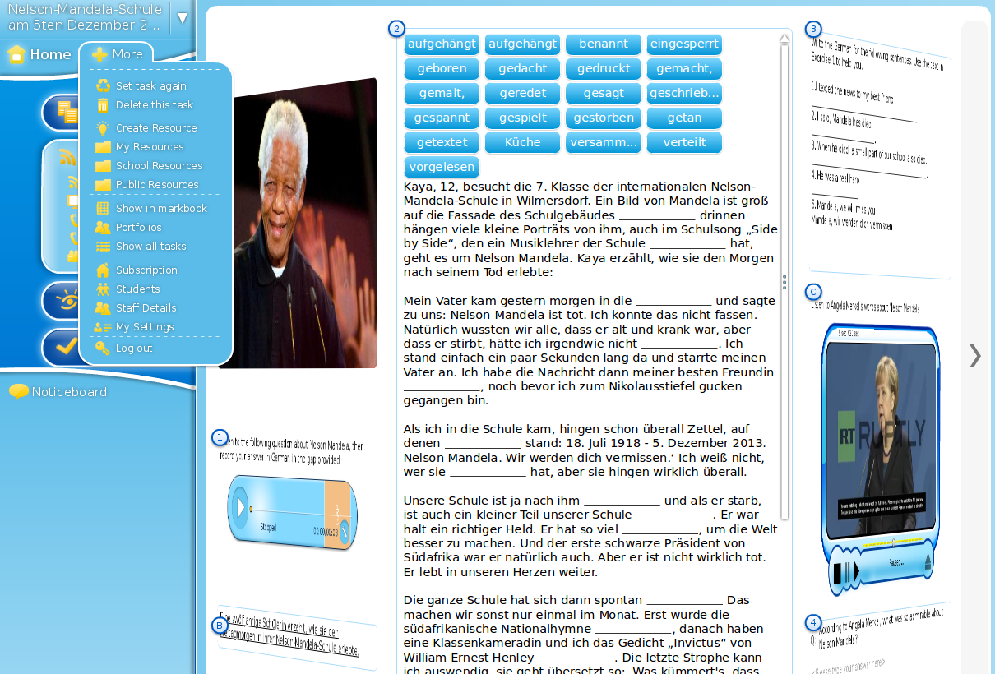
The ‘+ More’ menu
Notes:
After a while, students progress further with the task.
Here we see that Hermione is racing ahead. Although Neville has managed to get the right number of body parts finally, he is still behind.​​
*

Slide 47
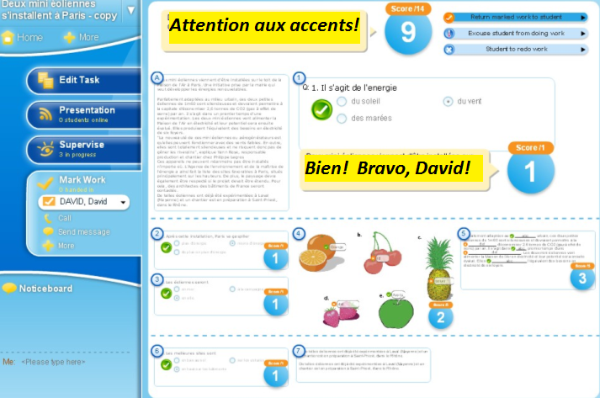
Automatic correction and feedback

Slide 48
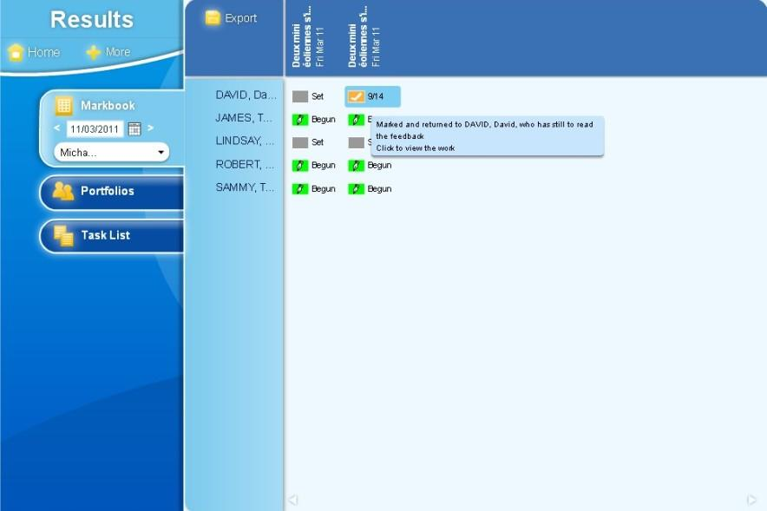
David’s work now corrected

Slide 49
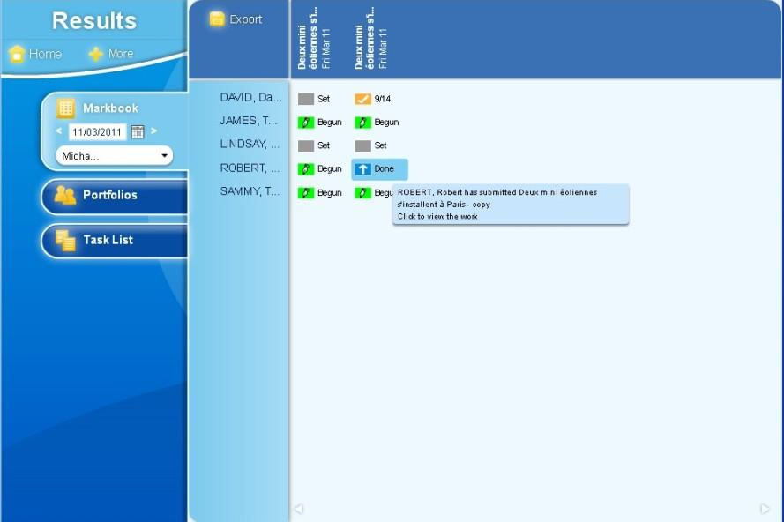
Select Robert’s work

Slide 50
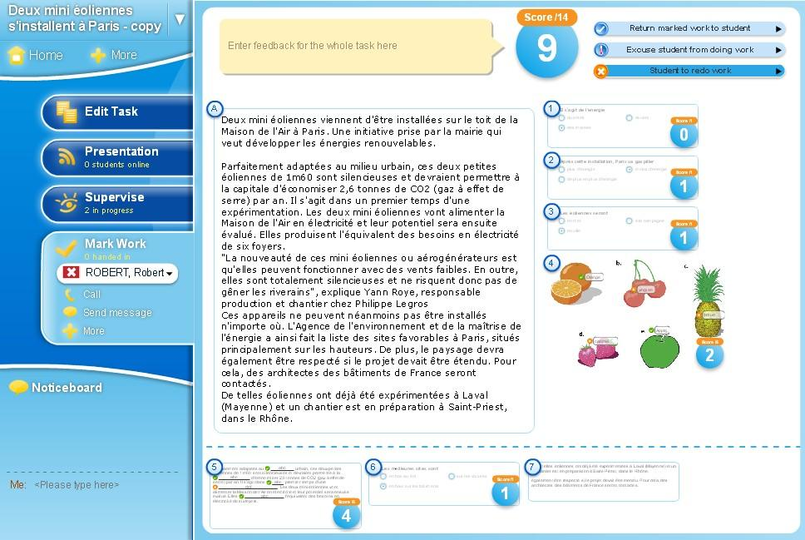
Tell Robert to redo his work!

Slide 51

Robert’s ‘redo’ in gradebook

Slide 52
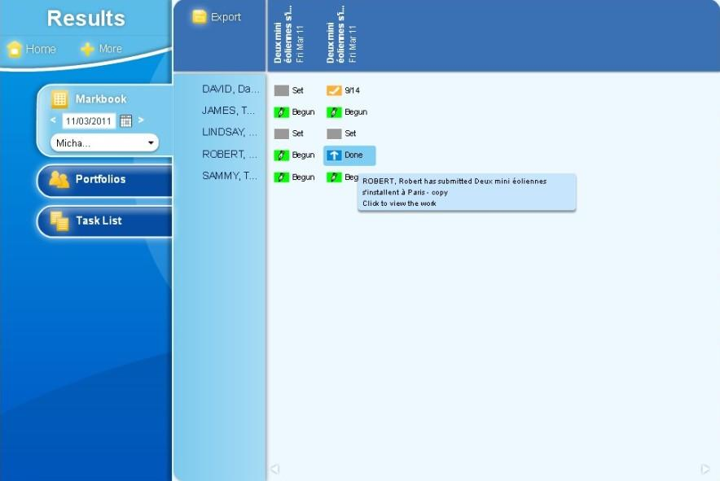
Robert’s task noted as ‘done’

Slide 53

Robert has improved his work

Slide 54

Robert’s better mark in markbook

Slide 55

Upload video to Schoolshape

Slide 56

Selecting staff details
Notes:
If you registered as an administrator in the Schoolshape Lab, you can add, remove or edit the names of staff in your school. You can also reset their passwords if necessary.

Slide 57

Staff details and resetting password
Notes:
As a Schoolshape administrator you can change staff details, roles and passwords by clicking the ‘edit’ or ‘Reset password’ buttons.

